Slide 1
Recipe
Box

Slide 2
Overview
A website to help you organize your favorite recipes!
You can create recipes and optionally save them to a section for easy finding!
You can search for recipes with the search option!
You can create a shopping list, how convenient!

Slide 3

Tools
Django Framework
Python
HTML/CSS
SQLite

Slide 4
Main Features
Basic account abilities: create account, login, change account info, logout
Recipe: create a recipe, edit it, add it to a section, pin it, or delete it
Sections: create, edit, delete, and add recipes for organization
Search: use search bar to find a recipe
Shopping list: add and delete items from your shopping list

Slide 5
Extra Screenshots

Slide 6
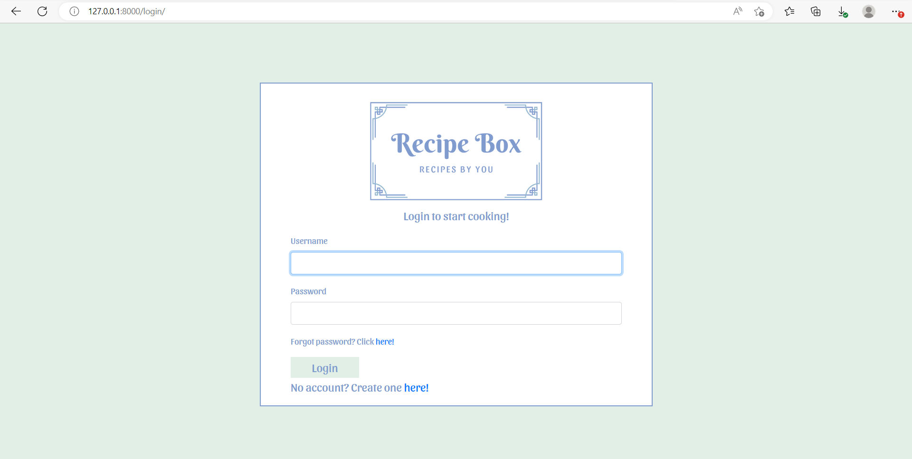
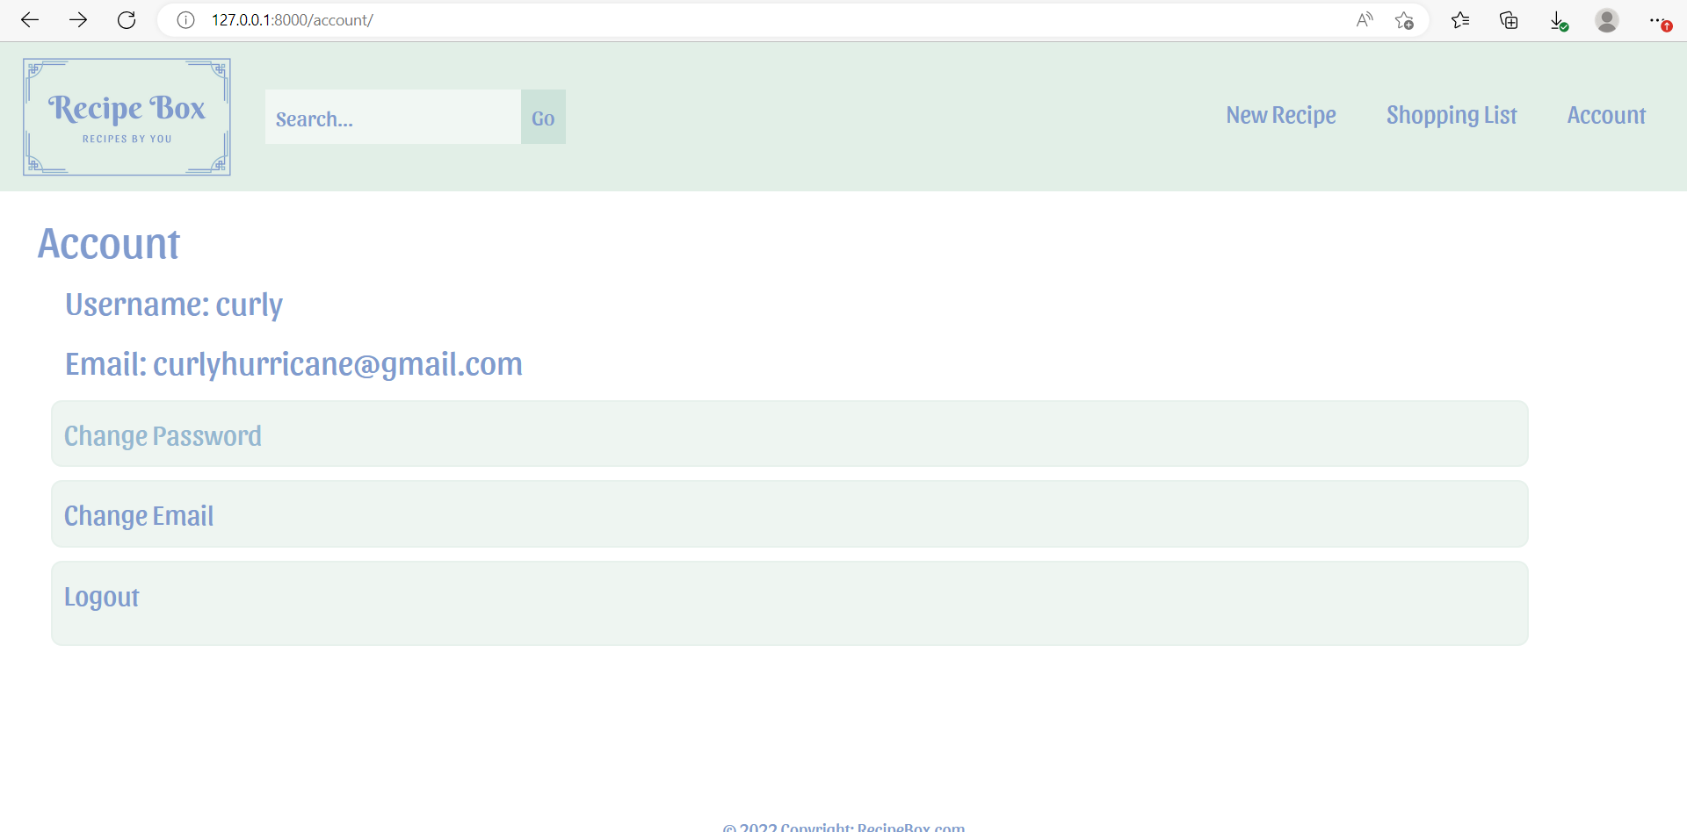
Account Features
Login Page
Account Page
Login
Create Account
Reset Forgotten Passwords
Change Password
Change Email
Logout

Slide 7
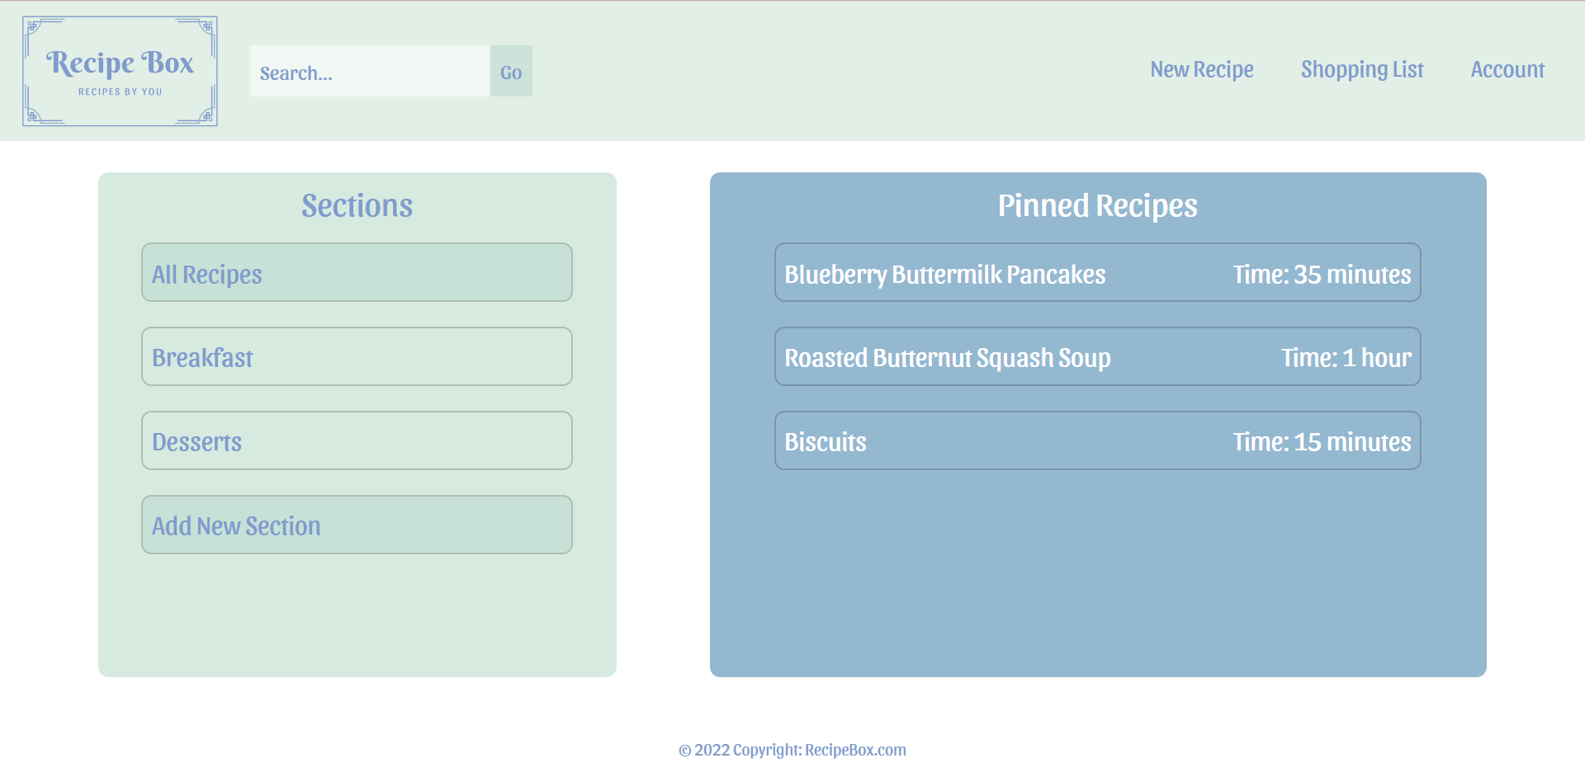
Home Page

Slide 8
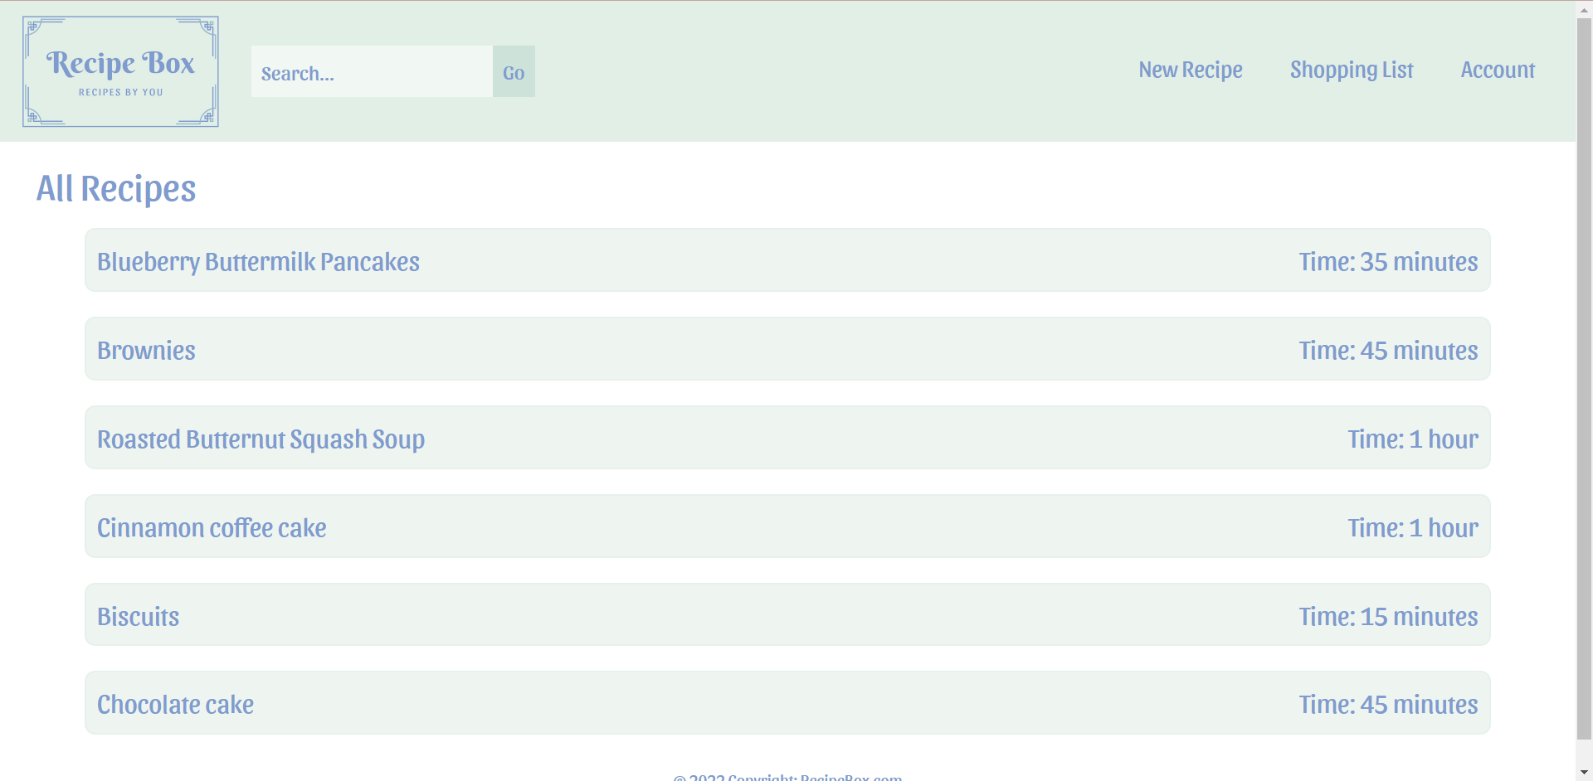
All Recipes

Slide 9
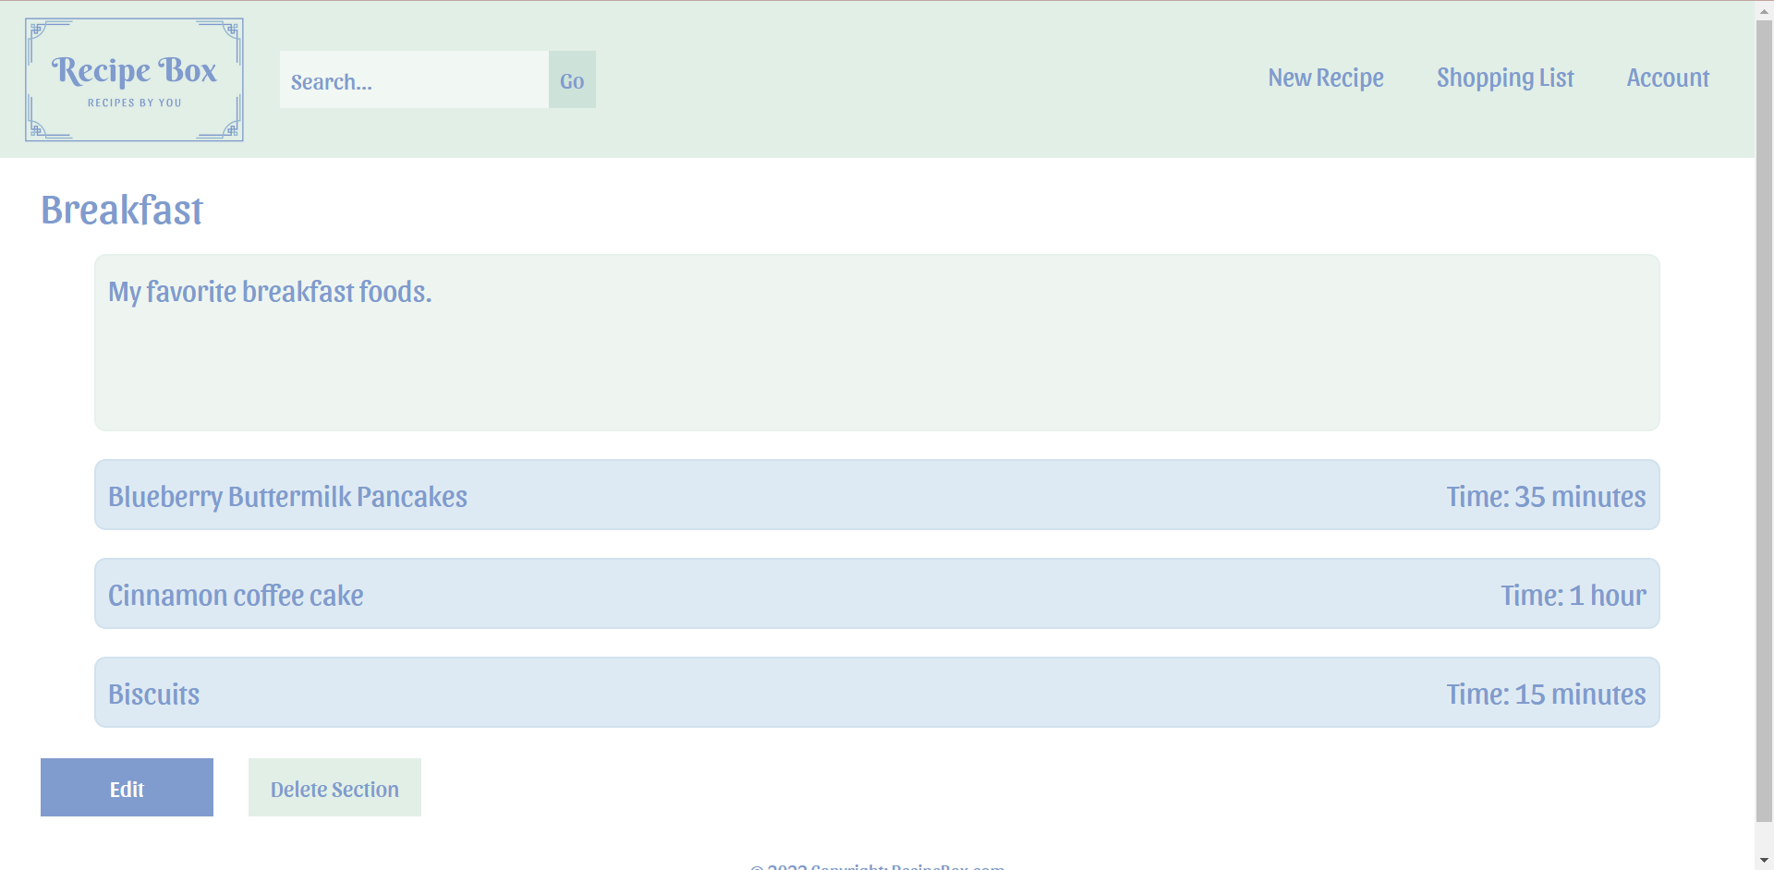
Create Sections

Slide 10
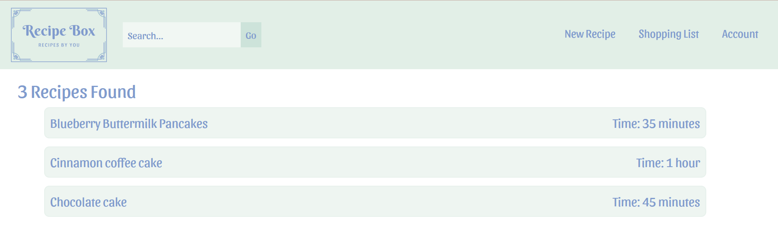
Search Your Recipes

Slide 11
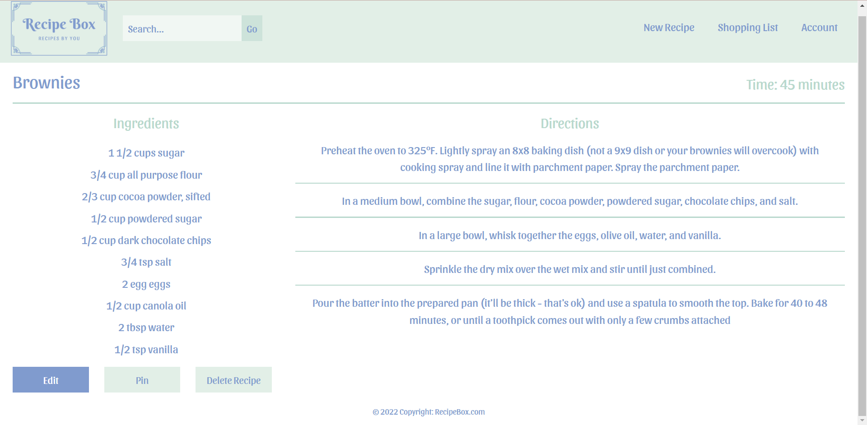

Slide 12
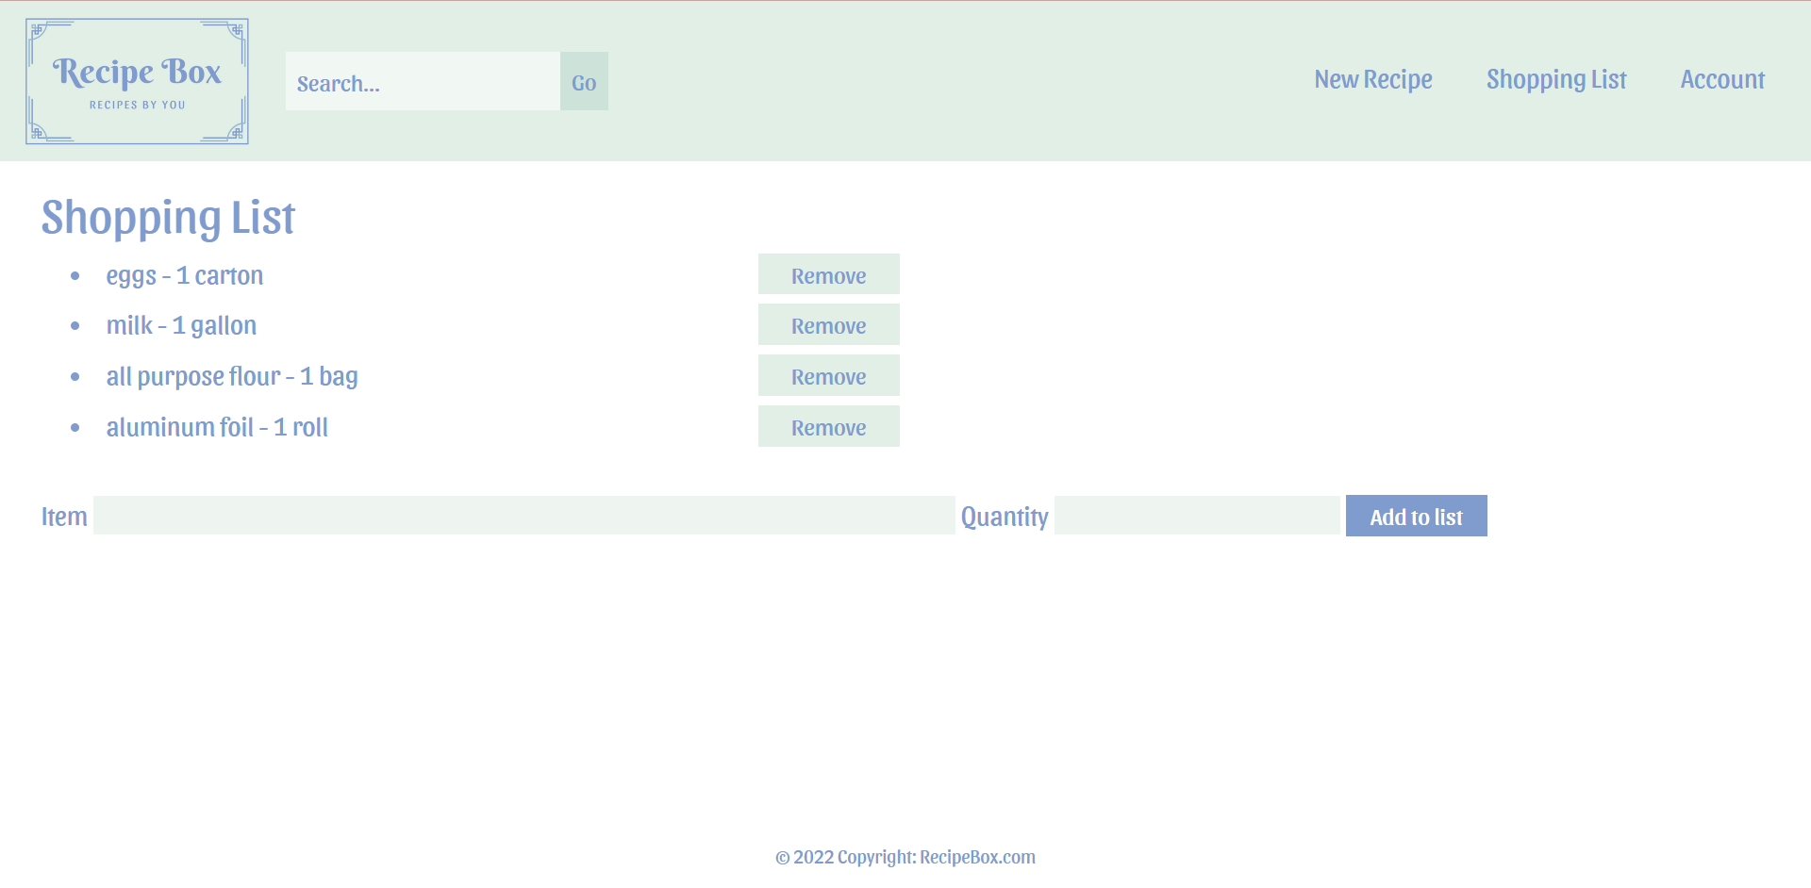
Create a Shopping List

